Slide 1
Automated dog bed
Created by David Barbour

Slide 2
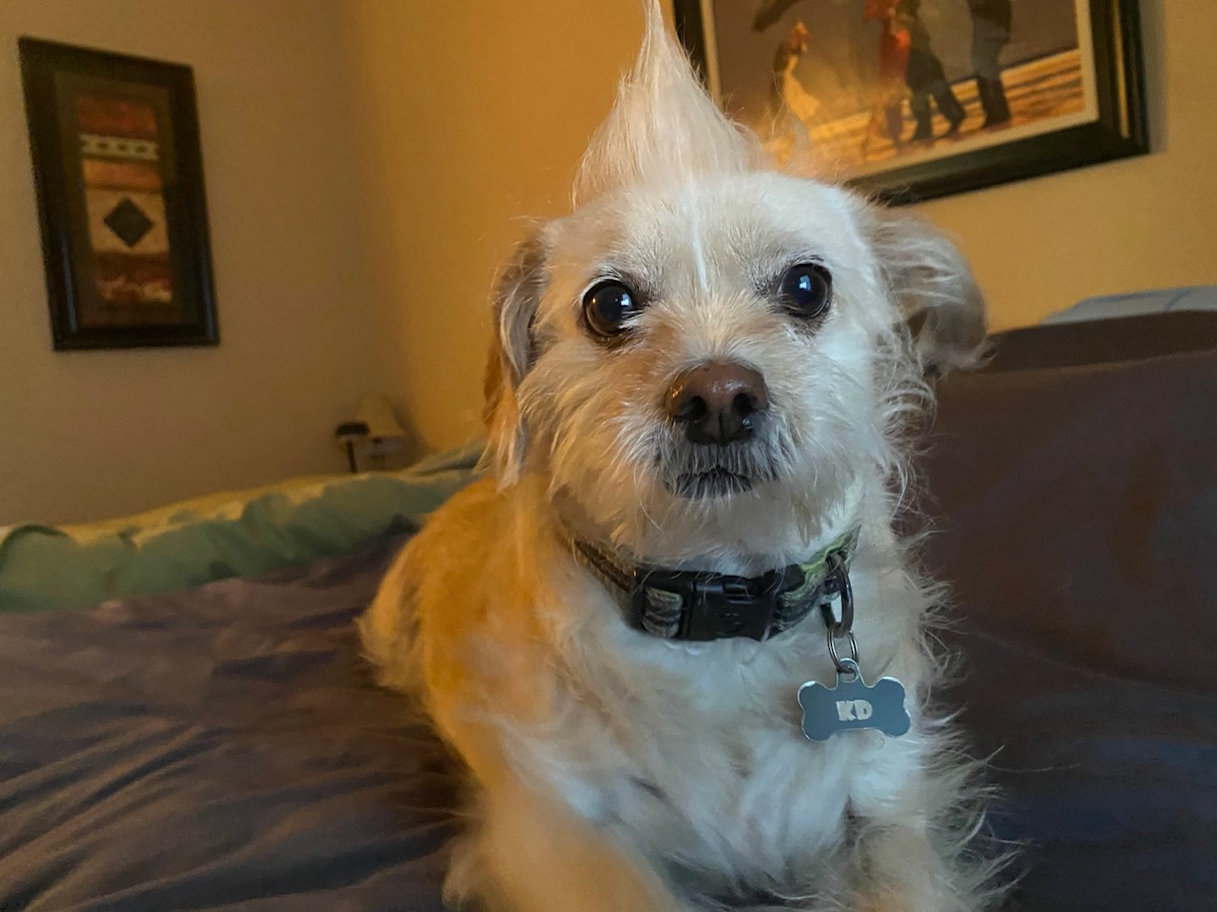
Khaleesi Daenerys

Slide 3



Slide 4
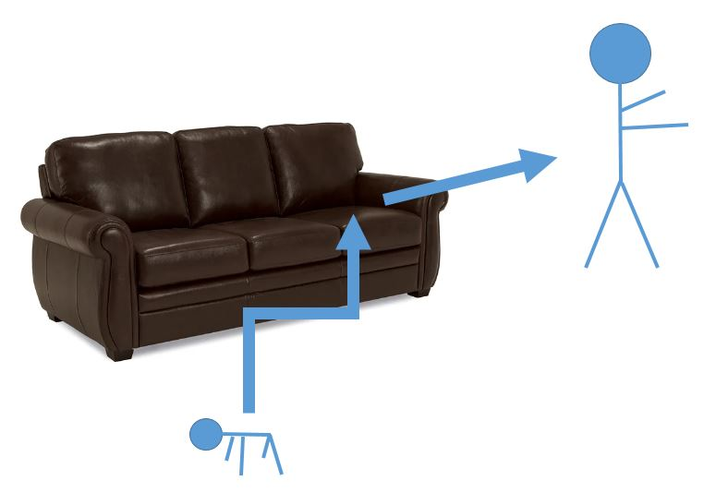
The problem

Slide 6
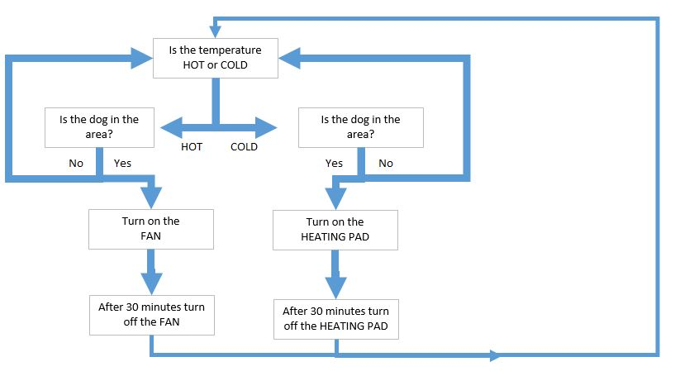
I needed something that will do this

Slide 7
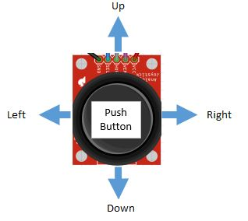
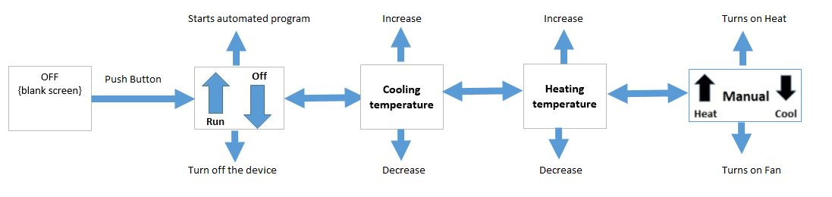
With this menu of options

Slide 8
Highlights
- Fully automatic or manually run
- LED acrylic sign indicating the state of the bed
a. blinking white – set up mode
b. breathing blue – waiting for motion to cool
c. solid blue – cooling
d. breathing yellow – waiting for motion to heat
e. solid yellow – heating
- Configurable temperatures
- Nifty guard rails to keep the dog bed firmly in place

Slide 9
Components and Materials
Materials
- dog bed crafted from scrap wood
- acrylic sign cut and etched on laser printer
- sign holder clamps, 3d printed
- sensor and electronics box, 3d printed
Components used
- neo pixels
- motion sensor
- temperature sensor
- OLED display
- joystick controller / push button
- hue light
- WEMO controlled fan / heating pad

